Slide 1
Software Testing and Quality Assurance
SWE 3643
M-W 6:30 to 7:15
Face to Face
Jeff Adkisson
JAdkiss1@Kennesaw.edu
https://github.com/jeff-adkisson
Please call me Jeff or Professor.
I am not a Doctor.

Slide 2
Welcome!
I am glad you are here.
I like to get to know everyone’s name, so anytime we talk or you ask a question, expect me to ask your name if I don’t know (or remember) it.
I am not great with remembering names, so expect me to take a while. It’s me – not you.
Hopefully, you will learn a little bit about testing and quality assurance. This is a large, complex topic and we will only scratch the surface of it.

Slide 3
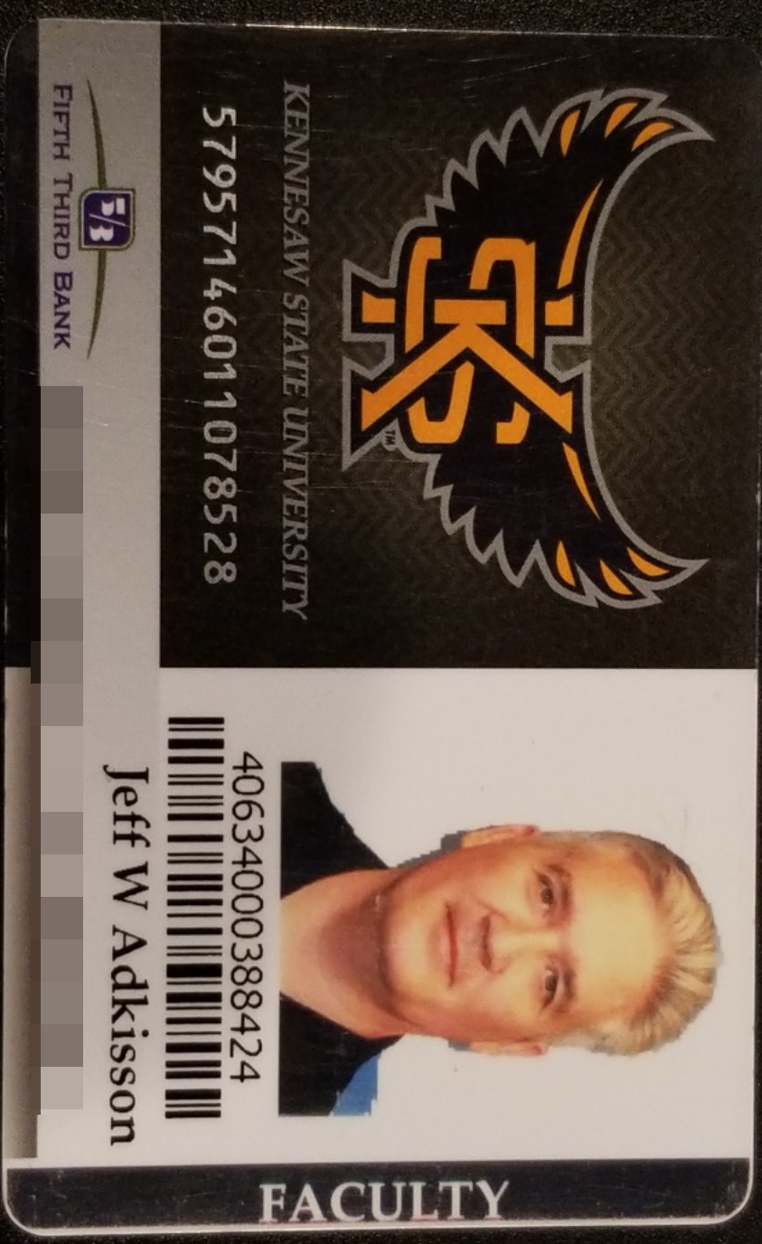
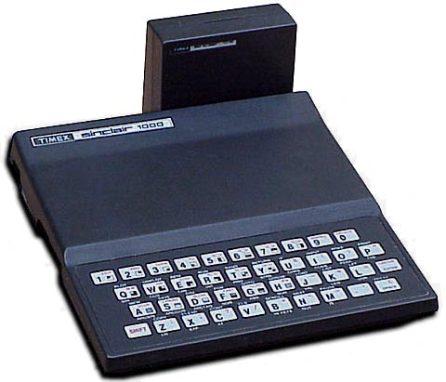
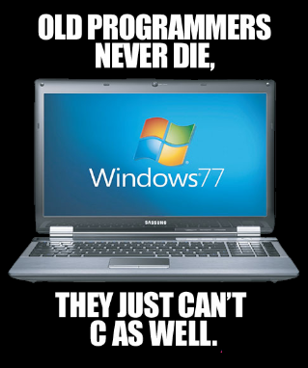
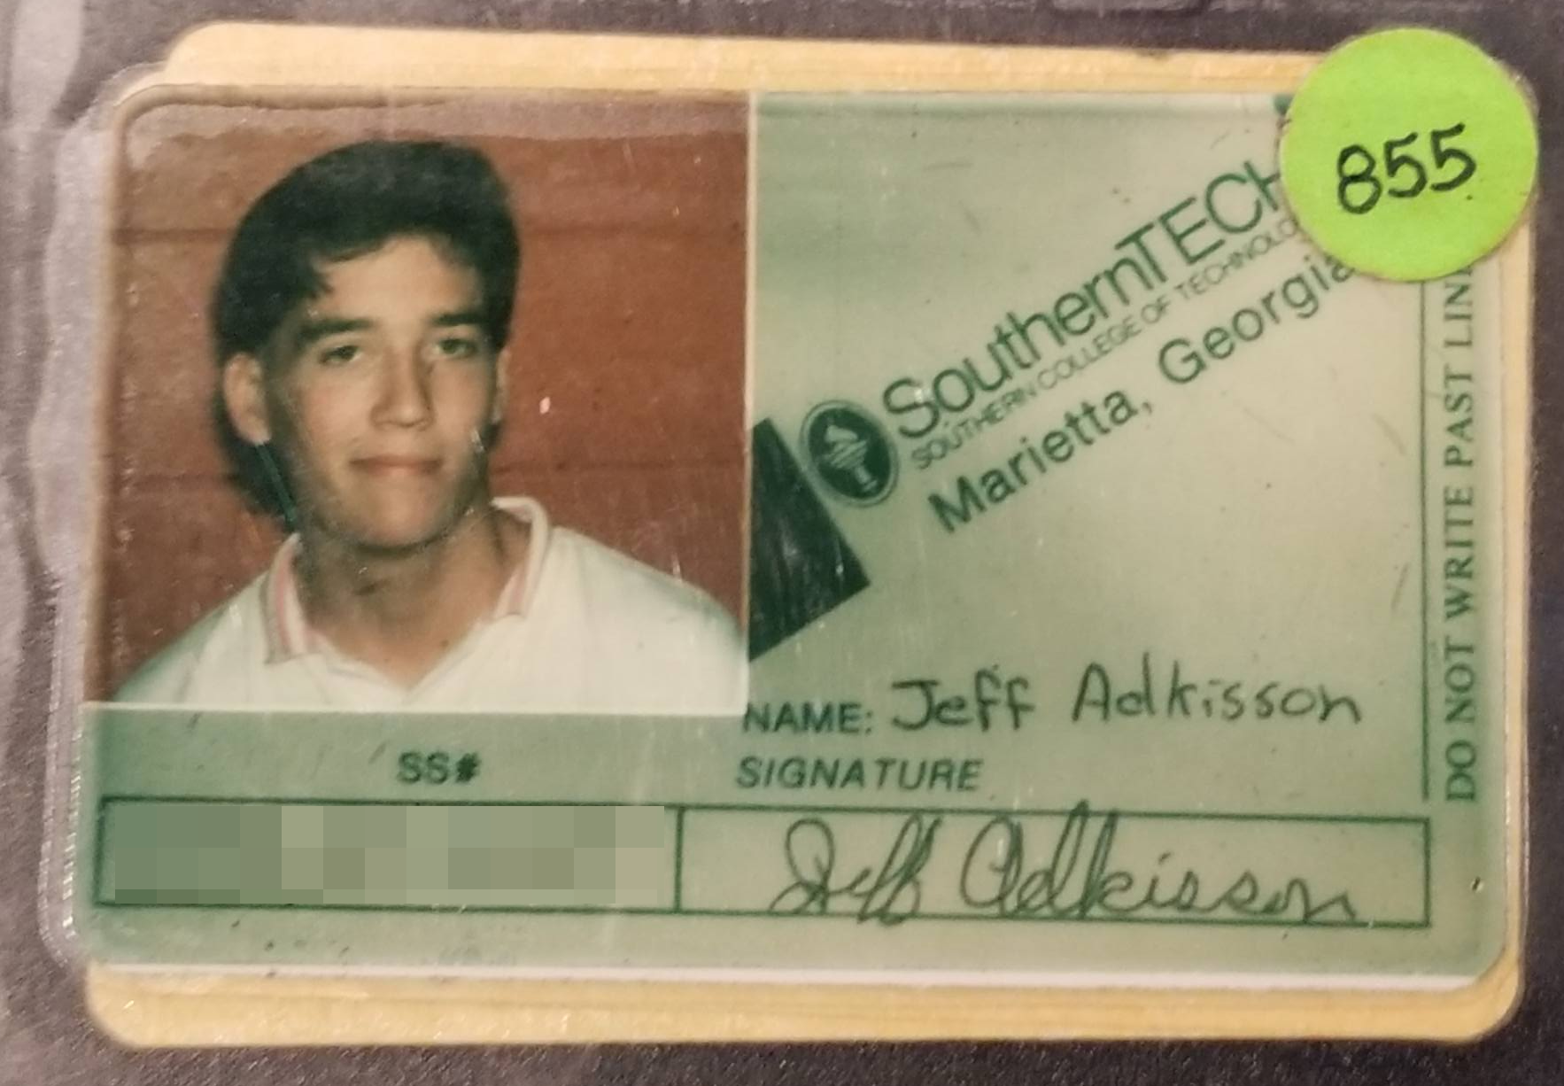
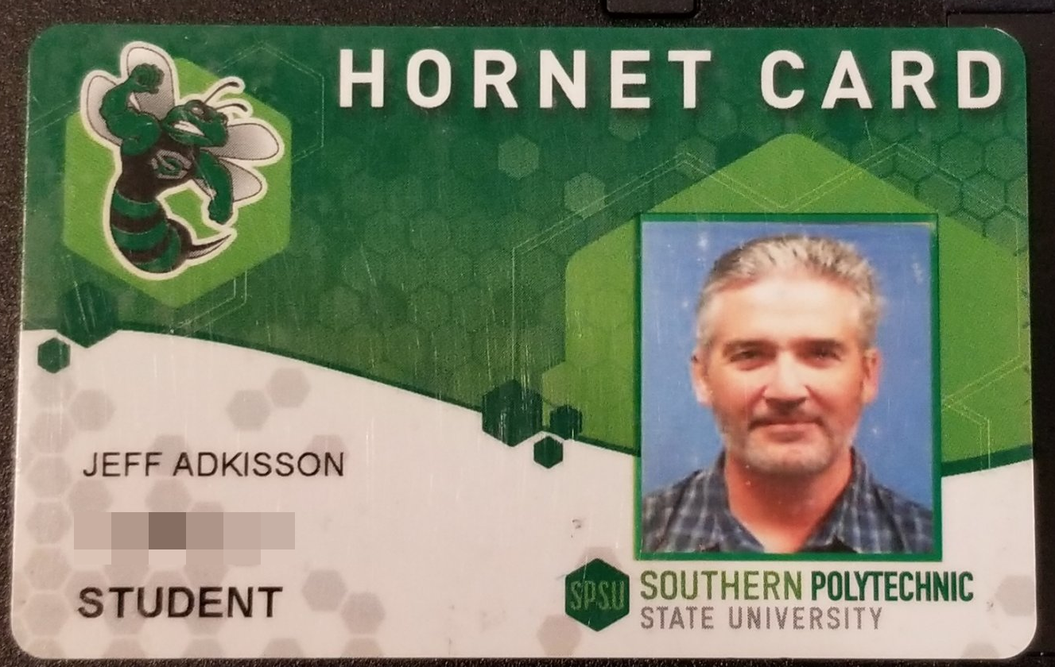
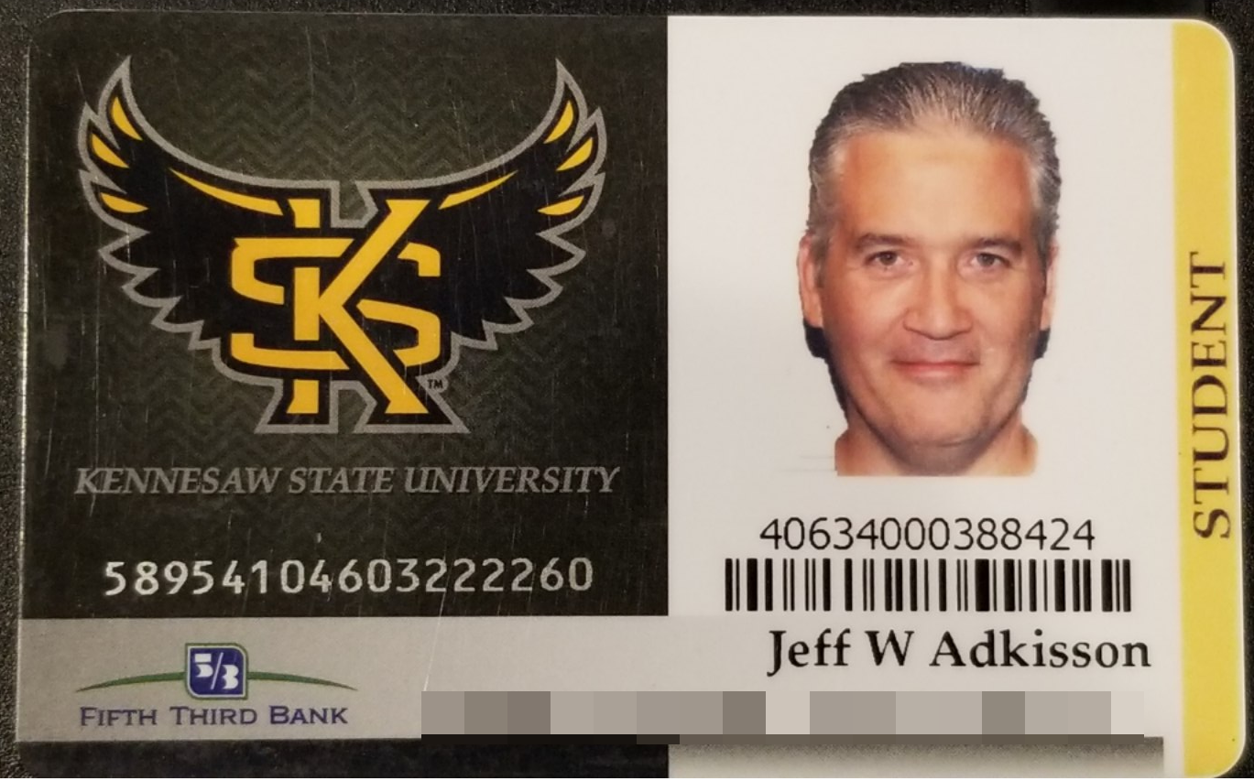
About Me
Started programming at 12 First computer Timex Sinclair 1000, 16k of RAM, Z80 processor
Started ACS program 1988 when this school was named Southern Tech
Worked in software field since 1994
Started CS Master’s in 2013 when SPSU
Graduated 2017 from KSU
Part-time KSU instructor since 2017

Slide 4
Where am I from?
I am from Georgia.
High School Pebblebrook in Mableton, graduated 1988 with a mediocre GPA and an average SAT score that got me into every college to which I applied. Times have changed.
Colleges Southern Technical Institute, now KSU from 1988 to 1990. Undergraduate from UGA in 1993 (a C student with an mediocre SAT score, LOL not these days) Masters Degree from KSU in 2017 (started under SPSU)

Slide 5
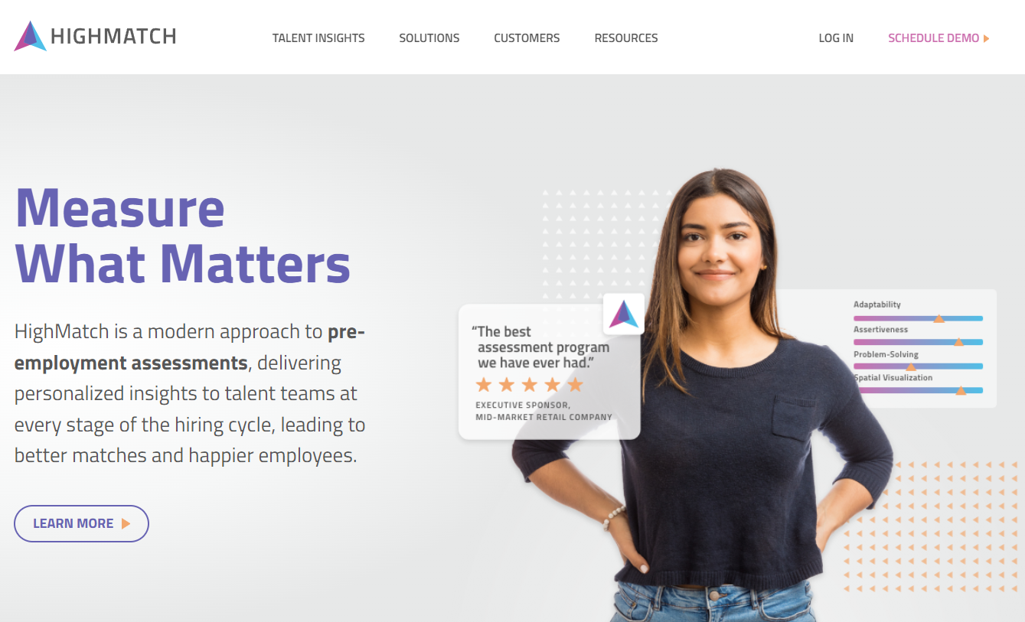
What I Do Every Day
Since 2010, I have been the Chief Technology Officer at HighMatch.
We create personality, cognitive, behavioral, and skills assessments that are delivered online.
Most of my job these days is design, documentation, recruiting, coaching, working with customers and vendors, and a little bit of management (I try to avoid hiring people who need a lot of hands-on management).
Our tech stack is mostly:
C# I write C# almost every day. I am much better with C# than Java.
SQL I can write the craziest SQL you will ever see. That is not a recommendation for writing crazy SQL.
HTML/CSS/Javascript/Typescript/Angular/Blazor I started doing web development in 1994.

Slide 6
Why Am I Teaching This Class?
I like to teach.
Sometimes I recruit former students to work at my company, HighMatch. I look for high-performing students who like to code, are strong communicators, and work well with others.
I plan to teach full-time someday when I retire from the industry.
I have made a lot of mistakes you can avoid. I will tell you about some of them.

Slide 7
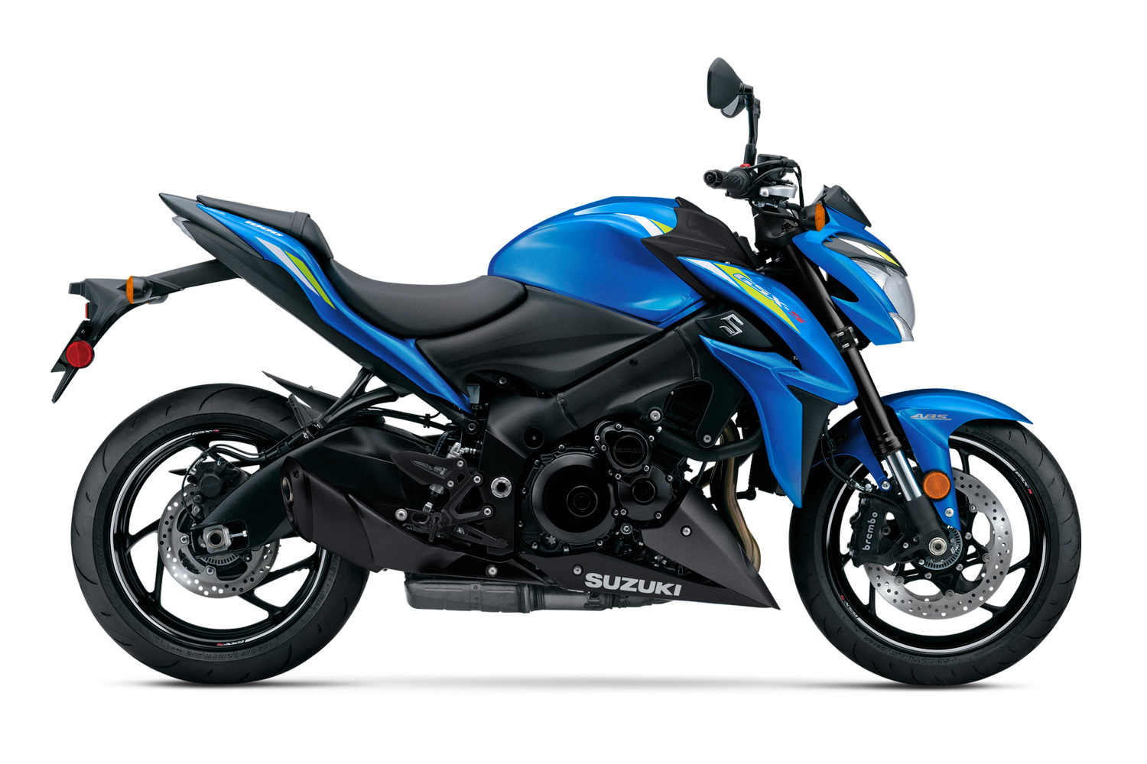
What I Like
Suzuki GSX-S 1000F

Slide 8
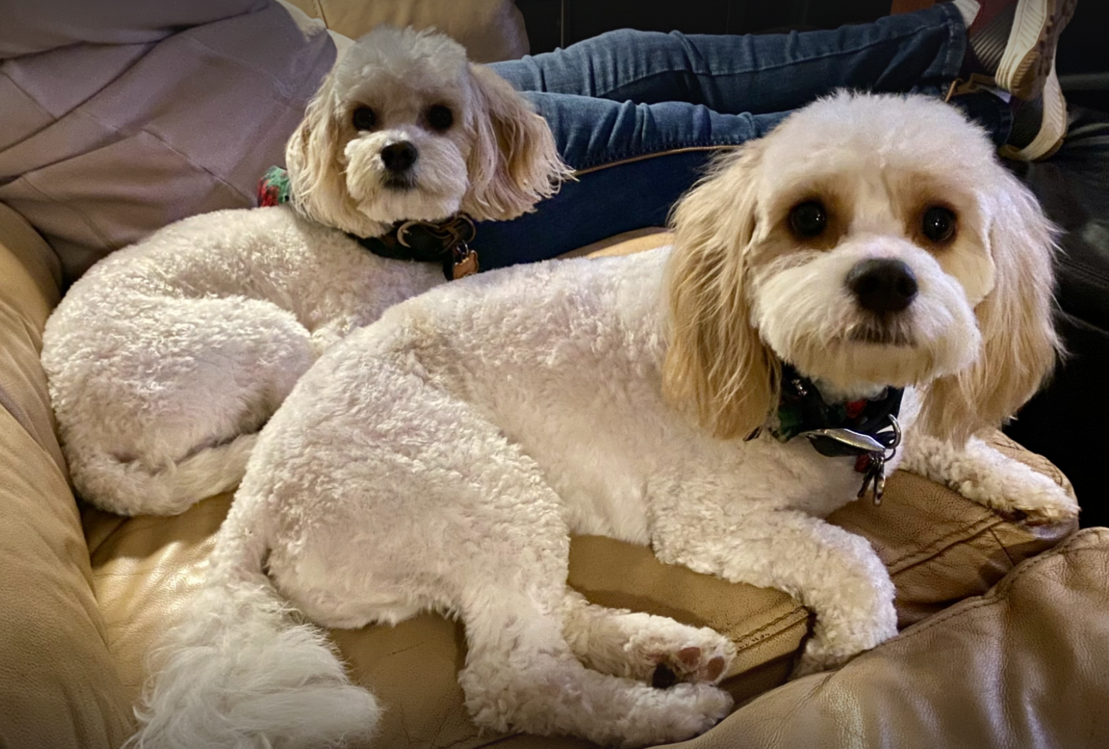
What I Like
Chloe
Smart
Barks
Digs
Territorial
Max
Not so smart
Great hair
Worships Chloe
Poops in the house
LOVES tennis balls

Slide 9
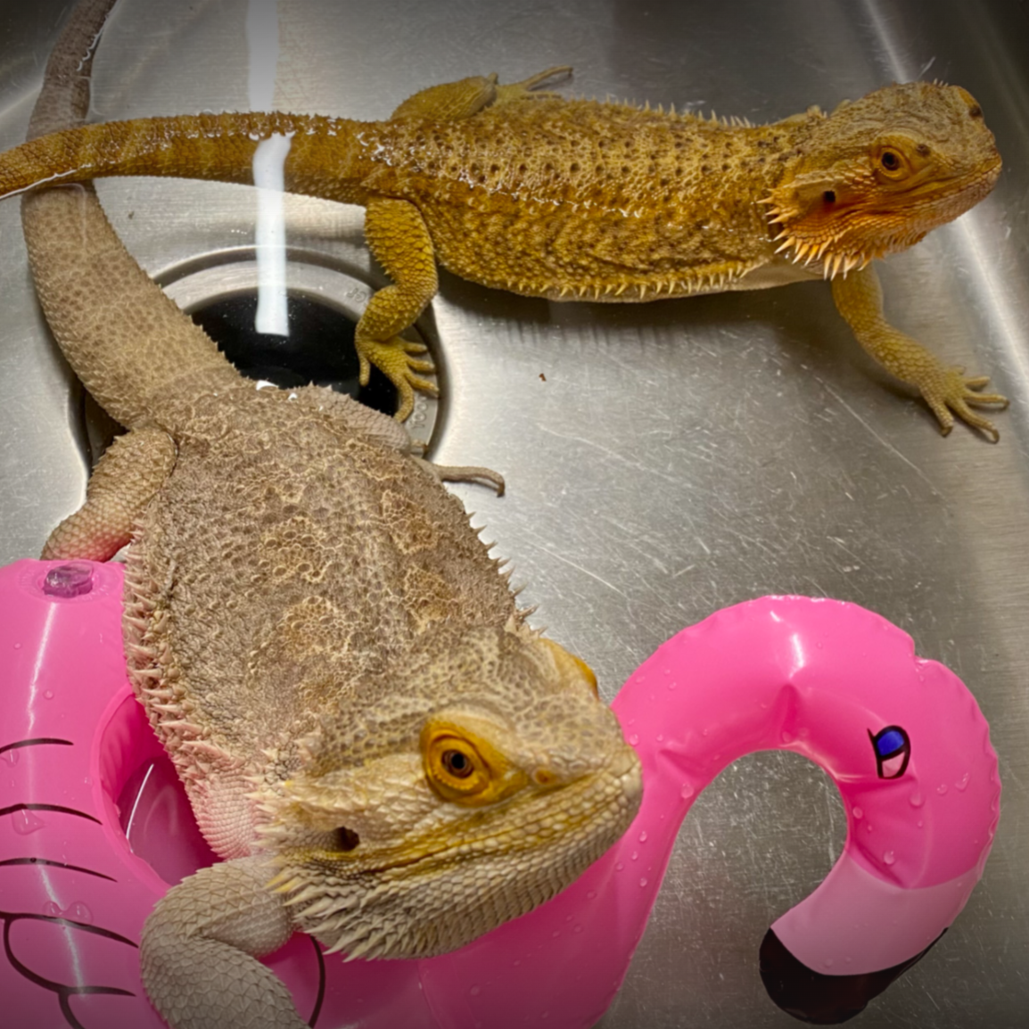
What I Like
Girlie
Belongs to Jeff’s college age daughter, Lyndsey
Every morning, pushes open her tank, jumps out, runs into the Dining Room, and curls up next to the piano
Thinks Poe should work out a little bit
Poe
Lazy… so lazy he must be hand-fed
Giant (for his breed)
Wants to be Girlie’s boyfriend

Slide 10
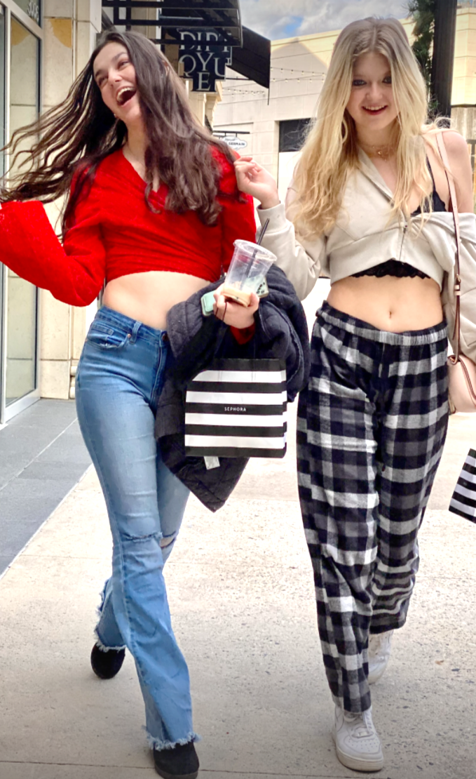
What I like
Lyndsey
Senior at Rider University, NJ
Musician and performer
Sydney
Senior in High school
Future salon owner
Has a giant Great Pyrenes named Mango

Slide 11
What to Expect in the Course
A mix of academic lectures and observations from 30 years of industry experience.
An emphasis on coding. A large coding project in this course is half of the course grade. You cannot master these concepts without writing code… learning them without applying them in code is like going to the gym and watching people work out.
An emphasis on professional-grade documentation. The longer you are in this field, the more time you will spend writing. The best engineers are outstanding communicators.
An emphasis on source control. That means git and Github right now. This is an essential skill for software engineers, and few, if any, of your other KSU courses are requiring you to learn it.

Slide 12
What to Expect in my Classroom
I do not care if you pay attention, but do not disturb or distract your classmates. If you want to text, play games, or watch videos, please do it elsewhere. Even if you are quiet, the person behind you might find your screen a distraction.
If you arrive late, leave early, or need to step out, that’s fine. Just do not disturb your classmates or me.
I do not take attendance. If you cannot attend, you do not need to tell me. It is your responsibility to understand the material I cover when you are not present. Please do not email me asking for a review of what happened.
Ask questions.
Correct me if I make a mistake. I am not perfect and I do not know everything.

Slide 13
I Want You to Graduate With…
- outstanding problem-solving and research skills. This is the most important skill you must develop to be a successful engineer.
- the discipline to grind through tough problems and manage your anxiety. Sometimes you have to sit at a desk all night just grinding on a problem. This still happens to me, even with many years of experience. This can be a very solitary, isolating, mentally taxing field.
- the understanding that you will never master this discipline, but you must always pursue mastery by learning new skills, mastering (and re-mastering) old skills, and avoiding getting too complacent/comfortable with your current abilities. This gets exhausting.
- the humility that you do not know everything, and will never know everything. This work will humble you over and over. Learn that there are very few ”never do this” or ”always do this” situations in real life.
- the ability to make a mistake, take accountability for the mistake, and learn from your mistakes. The last bit is the most important. As best you can, avoid making the same mistake twice. And as much as you can, learn from other peoples’ mistakes. Often, there are many paths to success, but never forget that there are infinite paths to failure.

Slide 14
Software Testing and Quality Assurance
SWE 3643
M-W 6:30 to 7:15
Face to Face
Jeff Adkisson
JAdkiss1@Kennesaw.edu
https://github.com/jeff-adkisson

